Slide 1
Stationary Management System
By
23071A0597 - M Hruday Karthik
23071A05B1 - P.Vedh
23071A05B3 - P.Vinay Sagar
23071A05B4 – P.Vinay Kumar

Slide 2
Agenda
1
2
3
4
5
Introduction
Why do we need this
Proposed Solution
Key Features
OS Topics

Slide 3

Problem Statement
The college stationery store often faces overcrowding, leading to long waiting times, confusion, and inefficiencies in serving students.
The lack of an organized queue system results in delays, as students have no visibility into their waiting time or queue position.
This causes frustration and disrupts time management for both students and staff. Additionally, peak hours make it difficult for the store to operate efficiently, further slowing down the service.
To address these challenges, a Smart Queue Management System is needed to streamline the process, provide real-time queue updates, and enhance overall efficiency.

Slide 4





Why Do We Need This System?
Long Waiting Time
Students often have to wait in long queues.
No Transparency
Students do not know their exact position in the queue or estimated wait time
Inefficient Manual System
Staff members struggle to manage the rush efficiently, causing delays.
Crowding Issues
Physical queues create congestion, making it difficult for both students and staff to operate smoothly.
Peak Hour Rush
Exam seasons lead to extreme delays.

Slide 5
Proposed Solution
To address the inefficiencies in the college stationery store, we propose a Smart Queue Management System (SQMS)that digitizes the queue process, reduces waiting times, and enhances user experience. This system will improve operational efficiency and ensure a smoother workflow for students and staff.
By leveraging modern technology, the system will provide real-time updates and automated notifications, allowing students to plan their visits more effectively. It will also help staff manage peak hours efficiently, reducing stress and increasing productivity.

Slide 6
Key Features
Digital Token System – Students can generate virtual tokens via a mobile app or kiosk, reducing the need for physical queues.
Real-Time Queue Updates – A display screen and mobile app provide live updates on queue status and estimated wait times.
Automated Notifications – Students receive alerts via SMS or app when their turn is approaching, eliminating unnecessary waiting.
Priority-Based Scheduling – Supports different scheduling methods like First-Come-First-Serve (FCFS) and priority handling for faculty or urgent requests.
User-Friendly and Scalable – Simple interface for students and staff, with the potential to expand to other services like the library or cafeteria.

Slide 7
OS Topics
OS Topics Used in the Smart Queue Management System
Process Scheduling – Manages the queue using First-Come-First-Serve (FCFS) or Priority Scheduling to decide the order of service.
Inter-Process Communication (IPC) – Uses message queues to send real-time updates about queue status.
Synchronization – Used to Avoid Conflicts in Token Generation
Multithreading – Allows multiple students to request tokens at the same time without slowing down the system.
Memory Management – Efficiently stores and retrieves queue data to keep the system running smoothly.

Slide 8
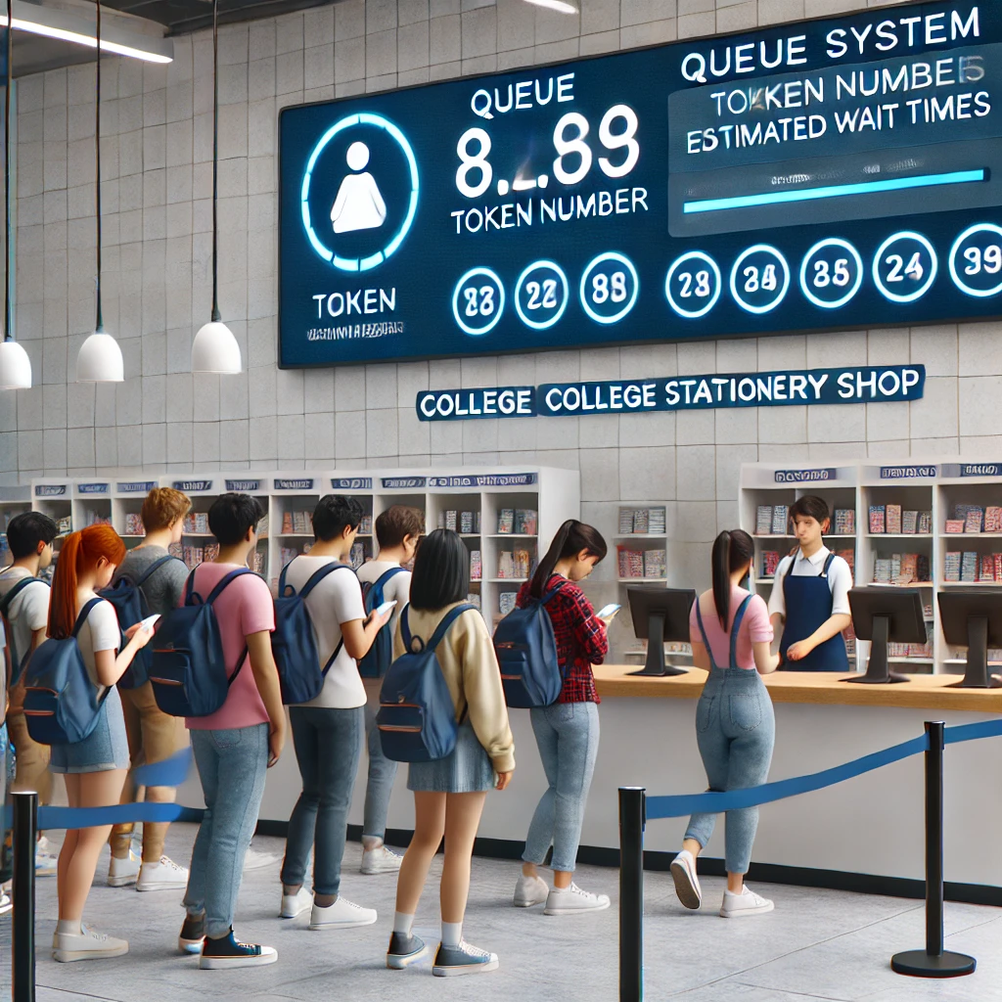
Conclusion
The Smart Queue Management System for our college stationery store aims to reduce waiting times, improve efficiency, and enhance the overall experience for students and store staff. By implementing a digital token system, real-time queue updates, and automated scheduling, this solution will ensure:
Faster service with structured queue management.
Convenience for students—no need to stand in long lines.
Less workload for store staff, improving their efficiency.
A scalable and flexible solution that can be expanded for other college services.

Slide 9
Thank you

